Slide 1












STUDENT MANAGEMENT SYSTEM MERN PROJECT
VKS STUDIOS

Slide 2
IN THIS PRESENTATION
STACK USED
ABOUT
01
02
The technologies used in this project
Aim of this project
Frontend
BACKEND
03
04
About the front-end modules
About the backend modules

Slide 3


STACK USED
01

Slide 4


MERN STACK
This project was developed using the MERN stack along with the Multer module for efficient image handling.
MongoDB – Used for structuring, organizing, and storing user data in a scalable NoSQL database.
Express.js – Provides a well-structured backend API layer for handling client-server communication.
React.js – Manages frontend routing, user interface design, and integration with backend APIs.
Multer – Configured to handle image uploads and store files on disk.
Node.js – Serves as the runtime environment for executing server-side JavaScript.

Slide 5
Aim of PROJECT
02

Slide 6
AIM / ADVANTAGES
ONE PLATFORM
REDUCED CLUTTER
EASY TO SEARCH
To provide students, teachers, and administrators with a unified platform that streamlines communication, enhances accessibility, and simplifies daily tasks.
Reduce paperwork clutter by transitioning to efficient, organized digital processes.
Enable fast and intuitive data search, allowing users to quickly find the information they need without manual effort

Slide 7
The frontend
03

Slide 8

MODULES
Under the hood, the frontend runs on many modules. Let’s spotlight the key players

Slide 9
Key pages/modules
TEACHER
STUDENT
ADMIN
Teacher module allows to mark attendance, schedule classes, manage grades etc.
Student module lets student access class schedules, see attendance, see their grades etc.
Allows admin to create teacher, student accounts, assign teachers work etc

Slide 10
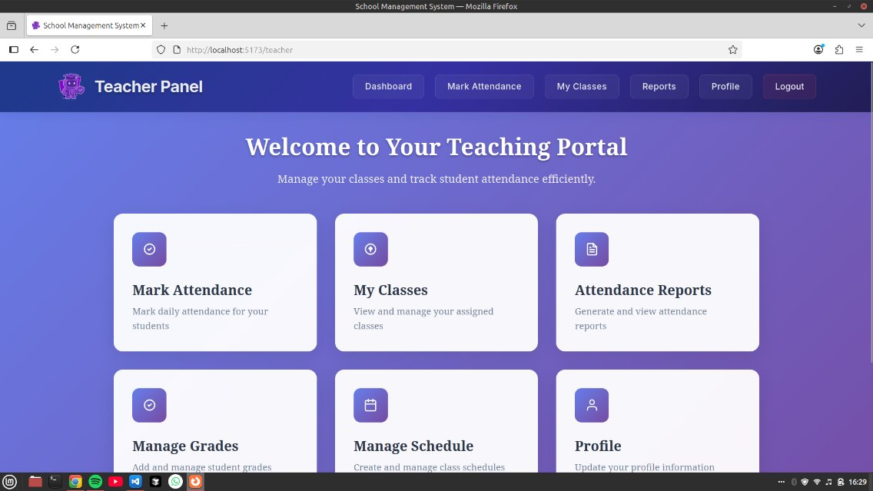

Slide 12
Key pages/modules
TEACHER
STUDENT
ADMIN
Teacher module allows to mark attendance, schedule classes, manage grades etc.
Student module lets student access class schedules, see attendance, see their grades etc.
Allows admin to create teacher, student accounts, assign teachers work etc

Slide 13
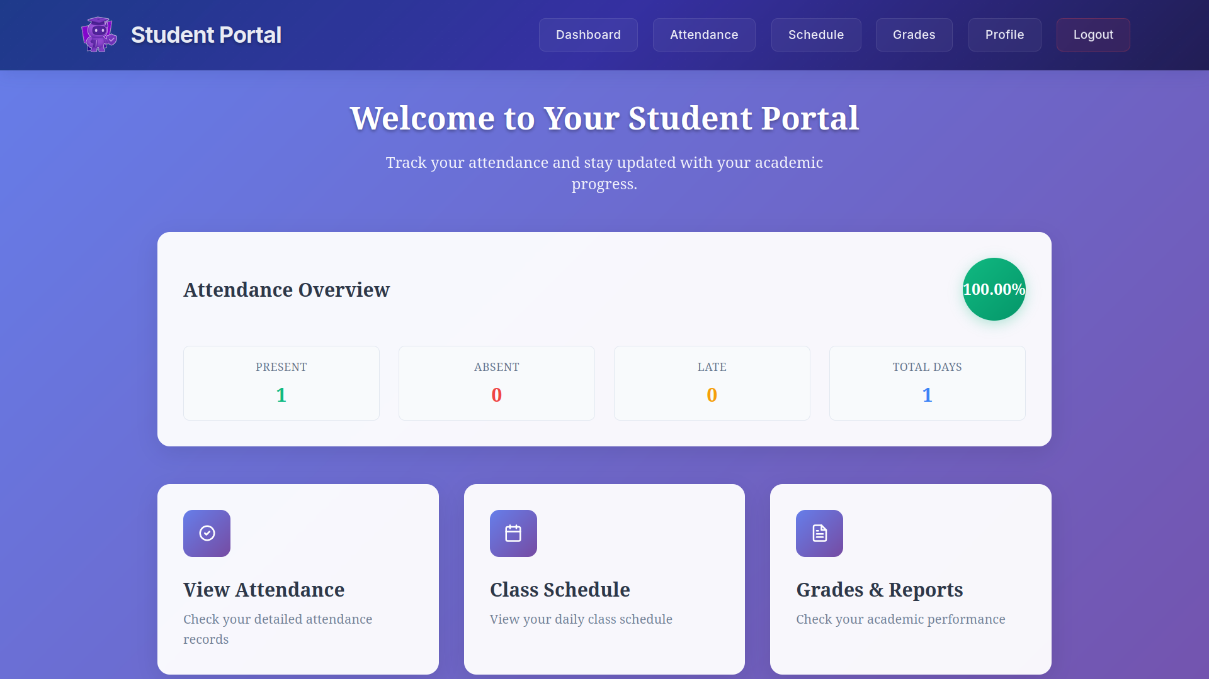

Slide 15
Key pages/modules
TEACHER
STUDENT
ADMIN
Teacher module allows to mark attendance, schedule classes, manage grades etc.
Student module lets student access class schedules, see attendance, see their grades etc.
Allows admin to create teacher, student accounts, assign teachers work etc

Slide 16
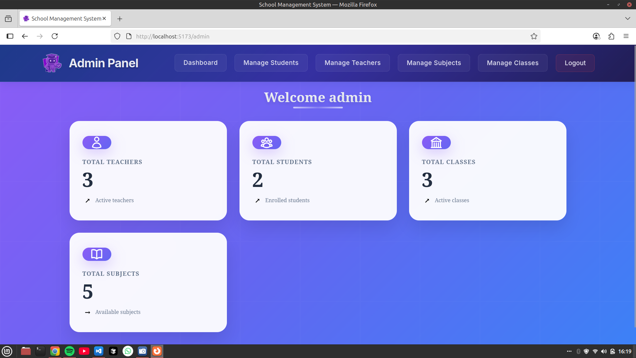

Slide 17
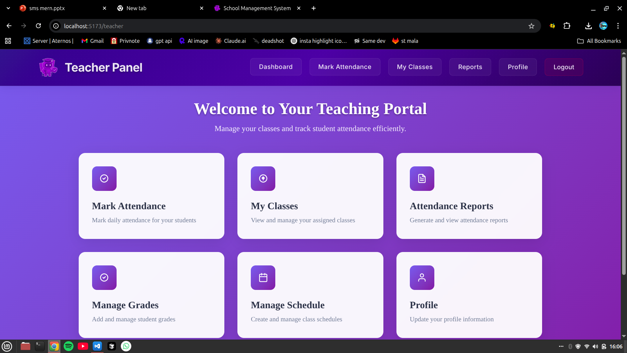

Slide 18
THE BACKEND
04

Slide 19
Modules used
ADMIN
STUDENT
TEACHER
BACKEND
EMAIL
MULTER SETUP
FEEs SYSTEM

Slide 20
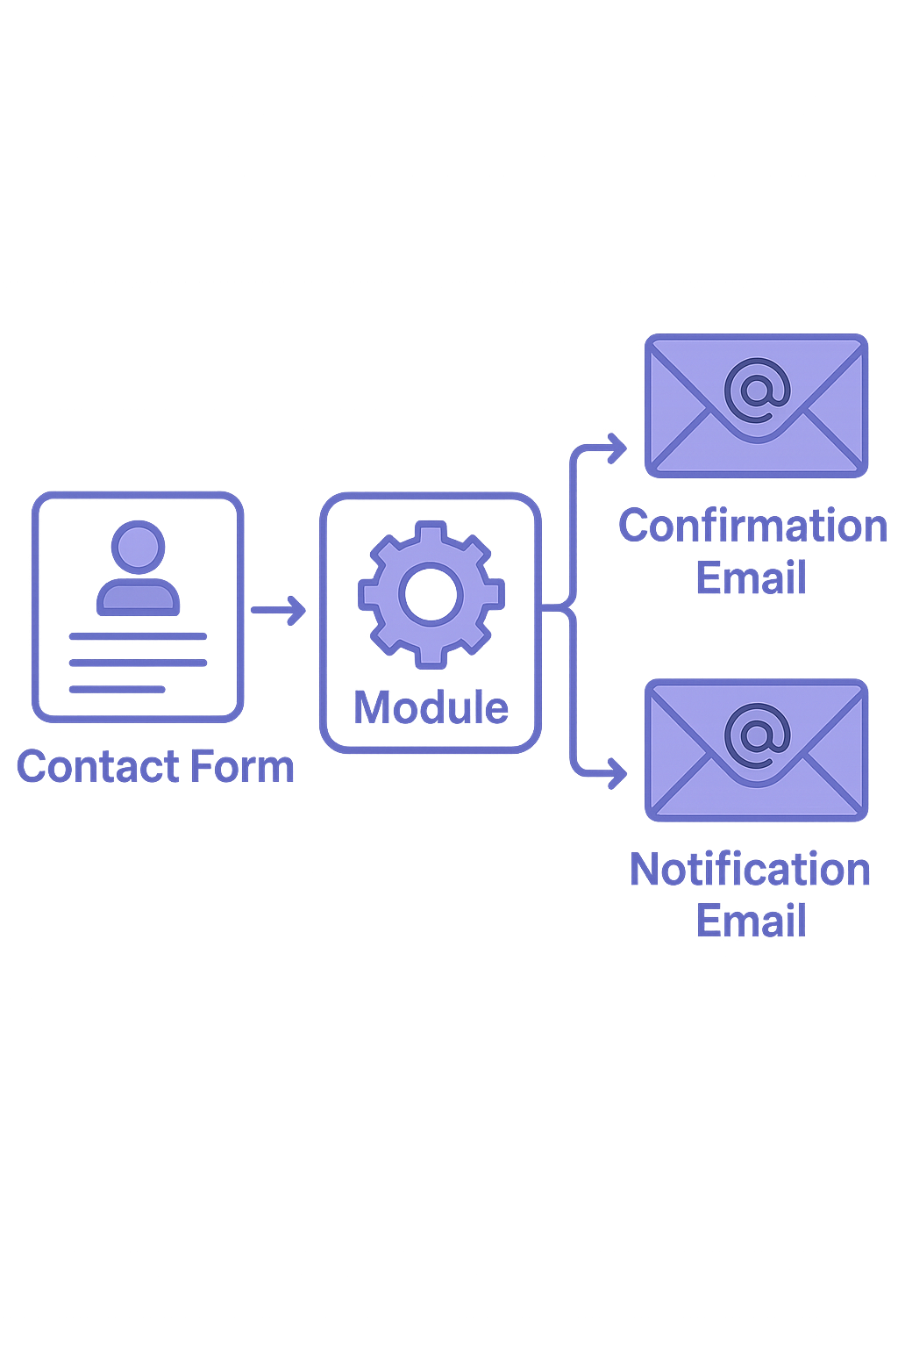
EMAIL SYSTEM
Since we’ve already covered the teacher, student, and admin modules in the frontend, let’s focus on the new ones instead.
This is the first Email System, which serves two purposes:
Sends an automatic confirmation email to the user when they submit the contact form.
Sends a notification email to the designated support staff so they can address the user’s query promptly.

Slide 21
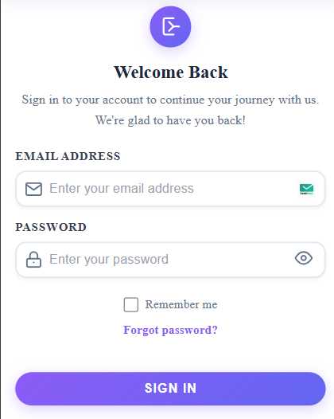
FORGOT PASSWORD SYSTEM
Let’s walk through how forgot password system works and the presenter explaining logic behind it

Slide 22
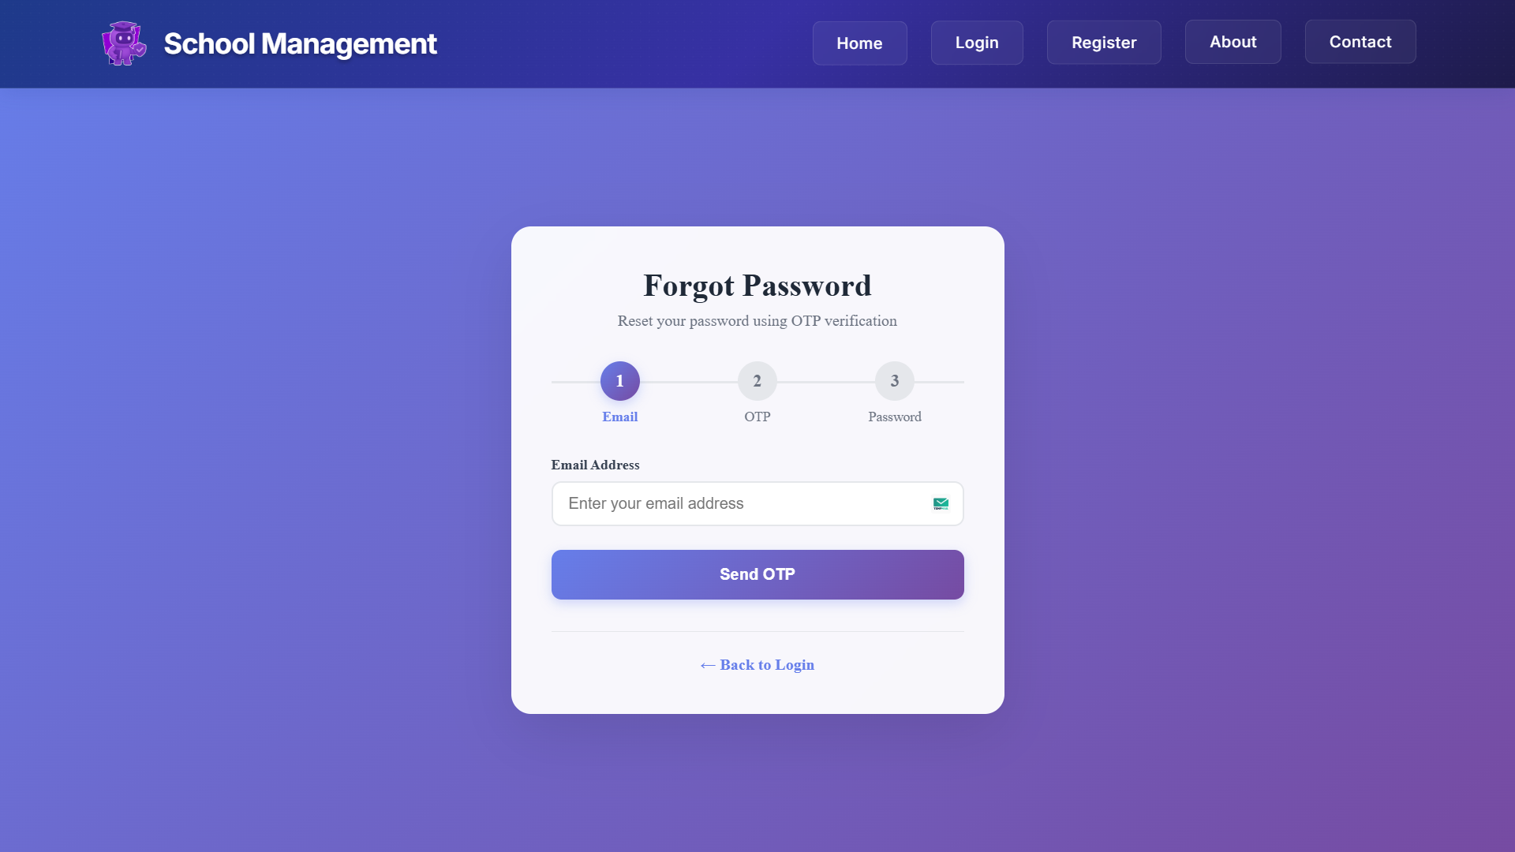

Slide 23
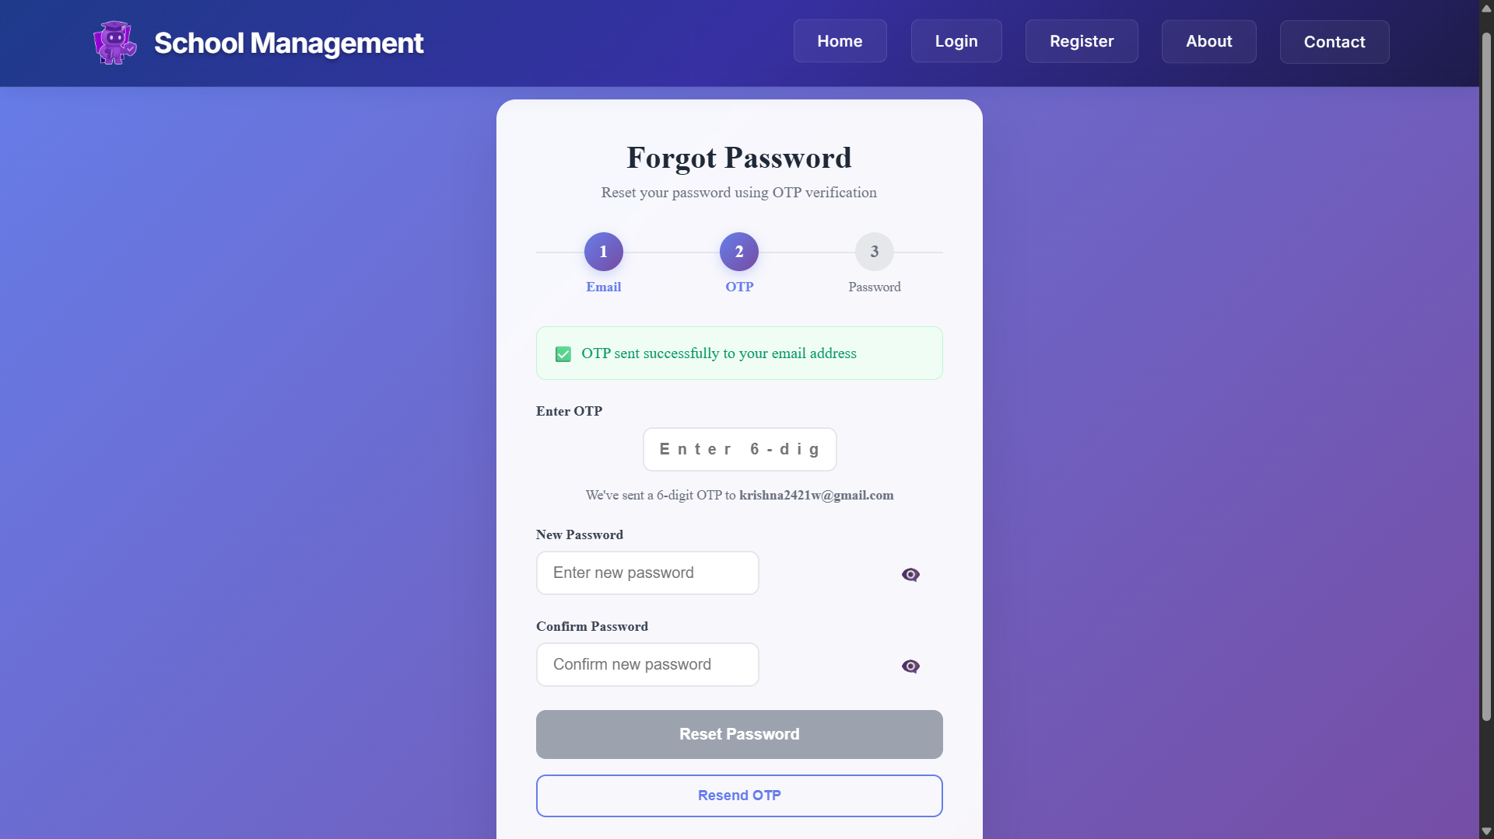

Slide 24
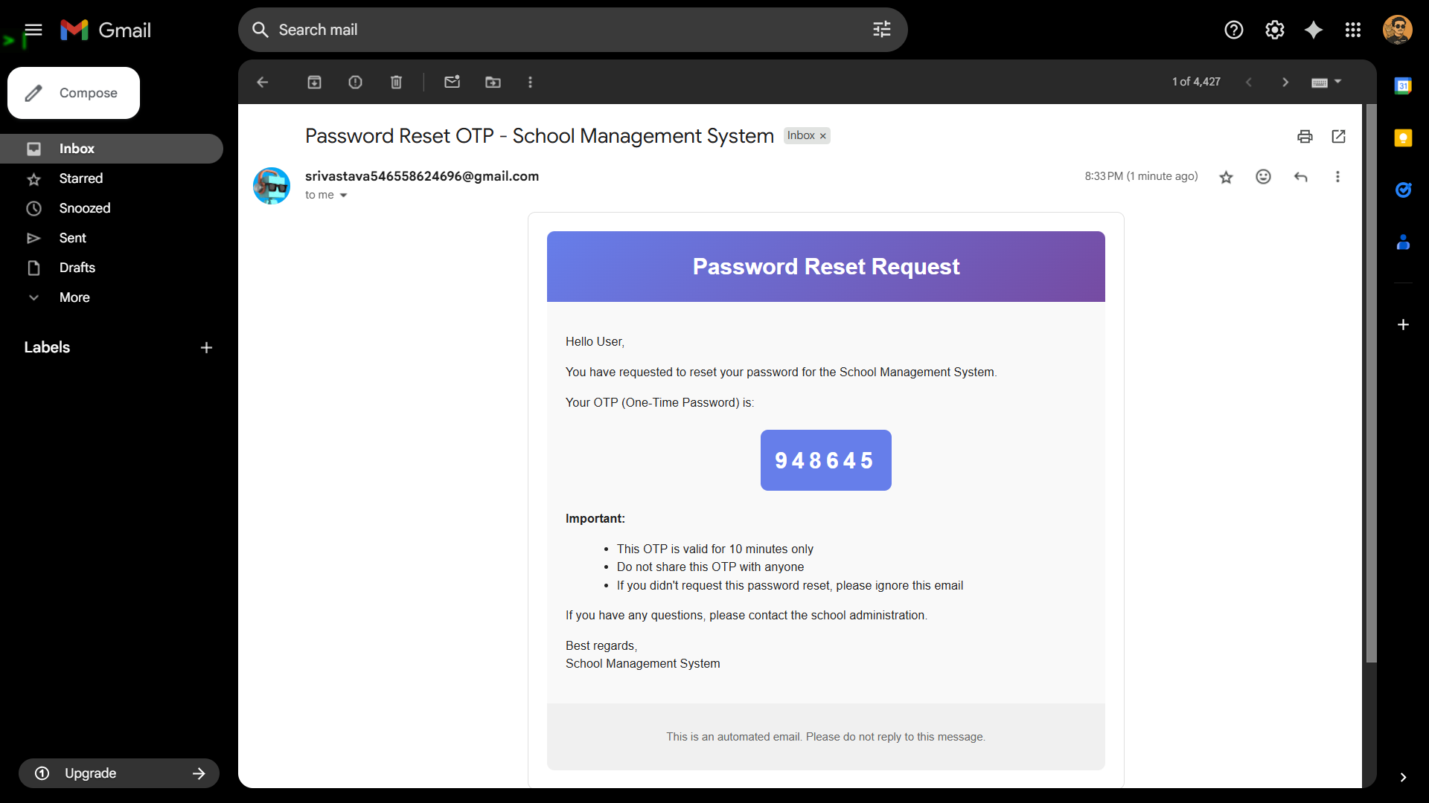

Slide 25
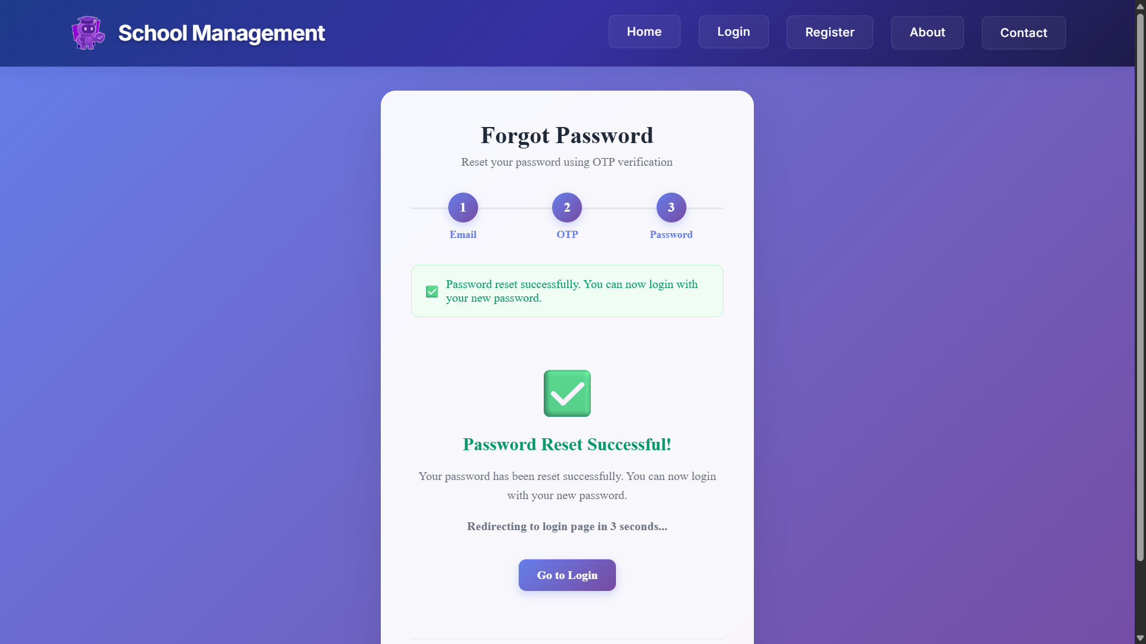

Slide 26
MULTER SETUP
USER ACESS
SANITIZE
user is uploading or accessing a file.
Cleans and validates file data for safety.
STORE
UNIQUE NAME
Saves the uploaded file in a designated storage location
Generates a distinct filename to prevent overwriting

Slide 27
FEES SYSTEM
Admin side
STUDENT SIDE

Slide 28
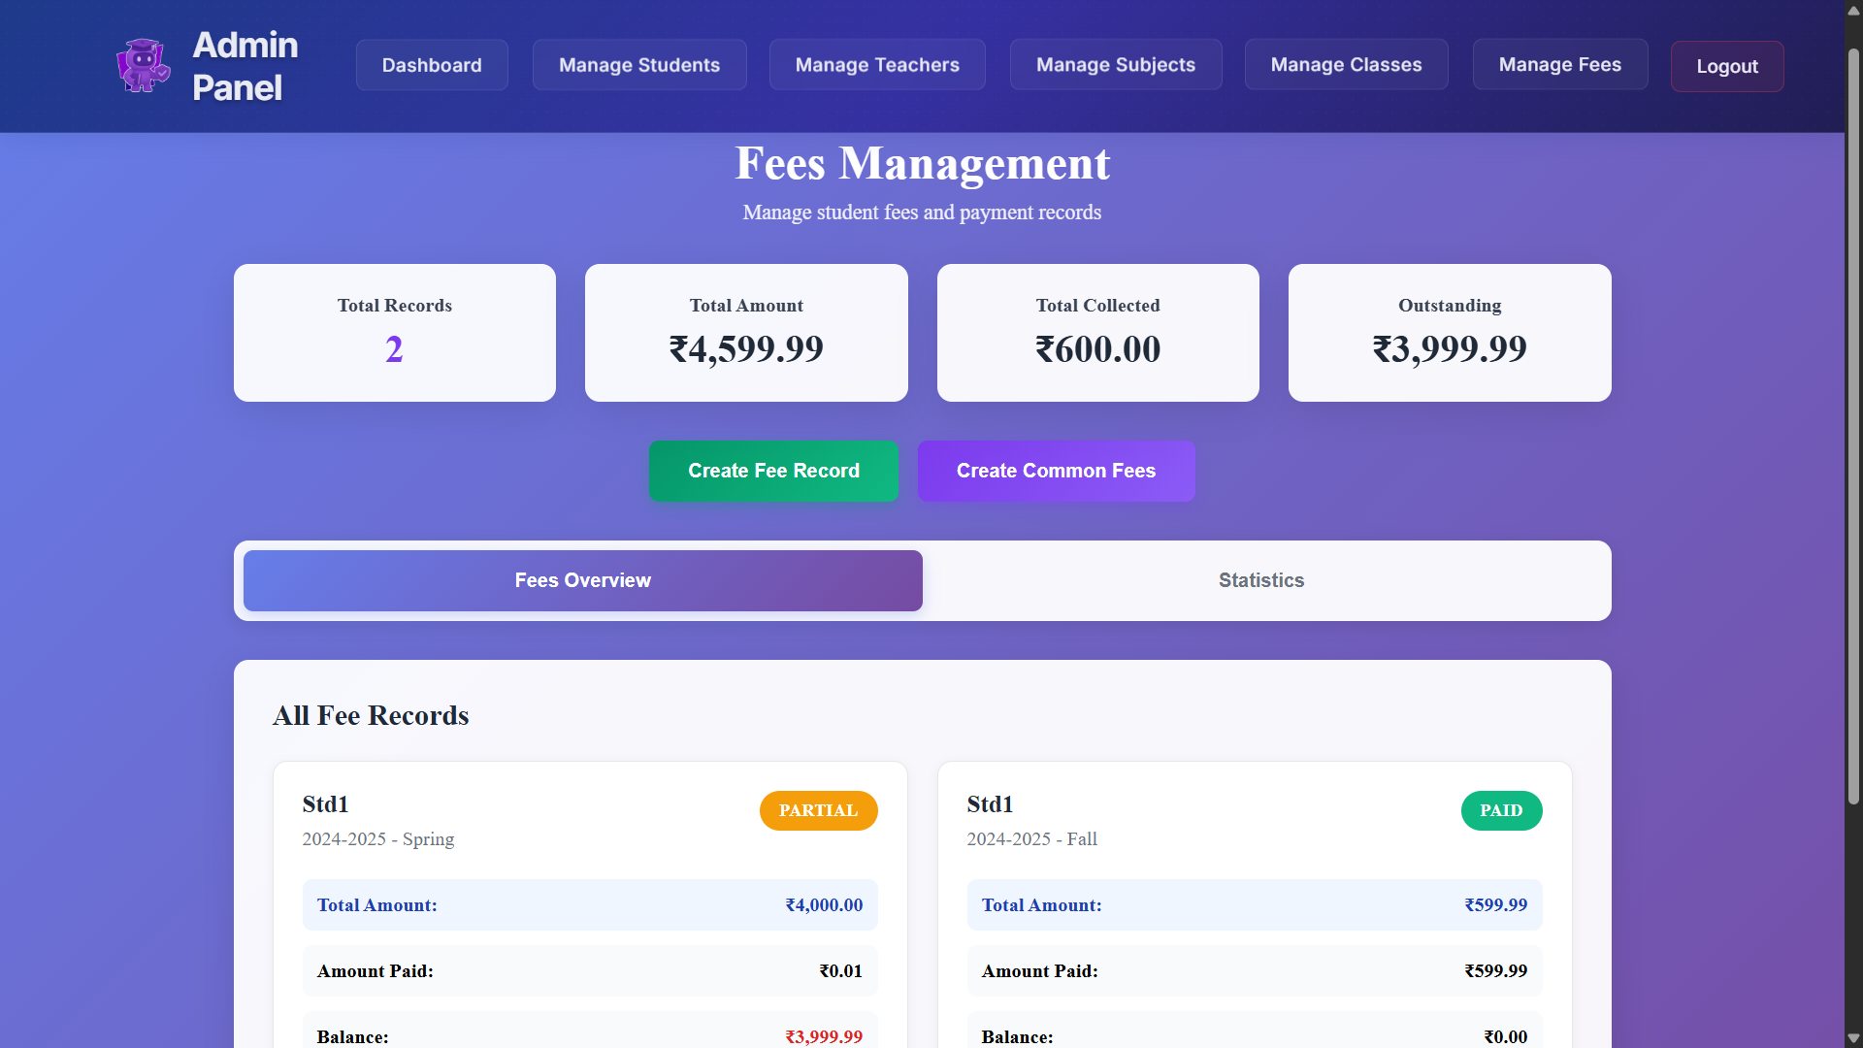
Admin side

Slide 29
FEES SYSTEM
Admin side
STUDENT SIDE

Slide 30
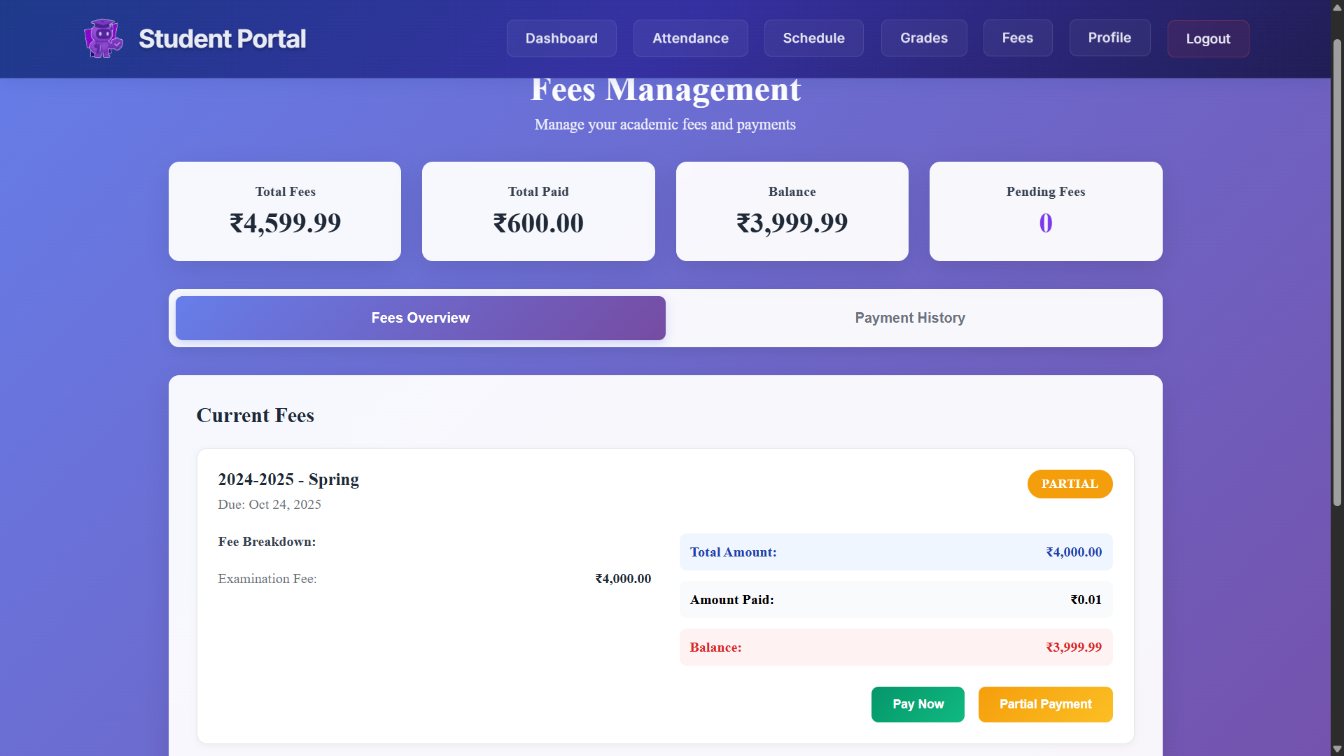
STUDENT SIDE

Slide 31

THANKS !
Does anyone have any questions?​

